Slide 1

Predicting home loan conversion
And the factors associated with it

Slide 2


Thank you for appointing us
Acknowledgments
The client is a global home loan bank
Perrine Mignot is the consultant:
12 years of Marketing experience
Master of Business and Marketing
Studying Data Science
For privacy reasons, we couldn’t name the client.

Slide 3

Agenda
Context and business question
Data and findings
Project pipeline
Predictive models
Determining factors
Recommendations

Slide 4





Context and business question
Company ‘s Objective
Challenges
Give an alternative to long home loans.
Many competitors in the market.
Problem
Solution
Predict customer’s conversion and define the key factors impacting conversion.
Large budget to attract visitors, hard to convert customers.
Notes:
The company is spending millions of dollars every year in Marketing to attract and convert visitors
Data question: Can we predict customer’s conversion and gather the features impacting conversion?

Slide 5




Data and findings - dataset
Structure
Main Features
Quality
155.000 raws/visits
39 attributes
1 June to 23 September 2020
Customers
Acquisition channels
Behaviour onsite
Conversion
Clean
Could have extra variables

Slide 6

Data and findings – visitors and customers
155.000 visits
90.000 unique visitors
730 visitors converted = submitted an application
Number of visits, visitors and conversions
Notes:
0.8% conversion rate

Slide 7
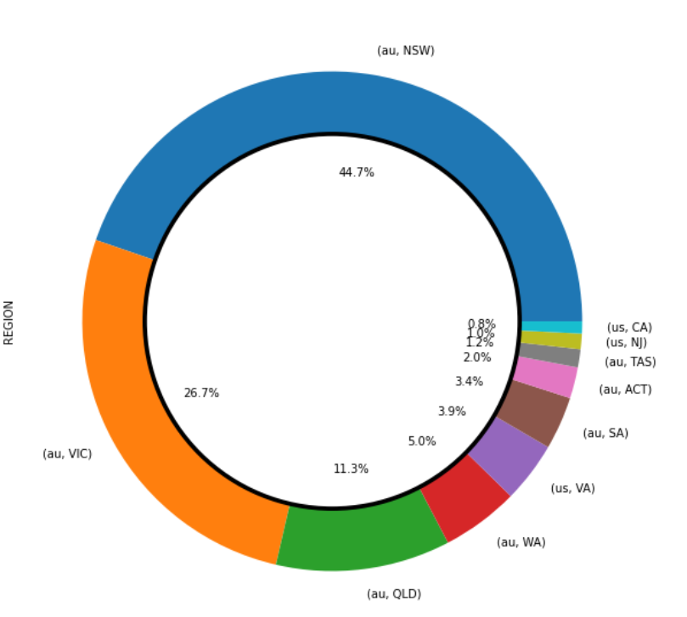
Data and findings – Location: visitors by state
Visitors by state
Visitors location:
Almost half of the visitors are from NSW
Followed by over a quarter from VIC
11.3% from QLD
5% from WA
3.9% are from Virginia, US, perhaps a future market

Slide 8
Data and findings – Location: conversion rate by state
Conversion rate by state
Conversion rate by state:
TAS and ACT have the strongest conversion rate
NSW has 0.85% conversion rate, the retargeting campaigns could be increased in this state
Same for QLD as both states represents over half the visitors base together
Conversion rate
Notes:
TAS and ACT have a strong conversion rate even if they only represent 3.2% of the visits

Slide 9
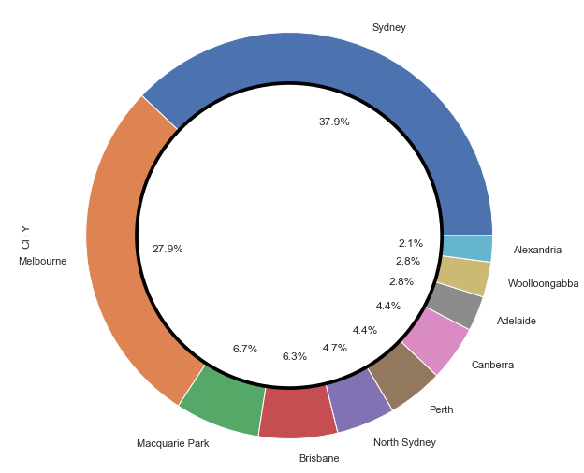
Data and findings – Location: conversion rate by city
Top 10 cities for conversion
The top cities where conversions come from are:
Sydney and Melbourne by 65%
Business districts convert well (11%).
Might be worth targeting business districts around the country.

Slide 10
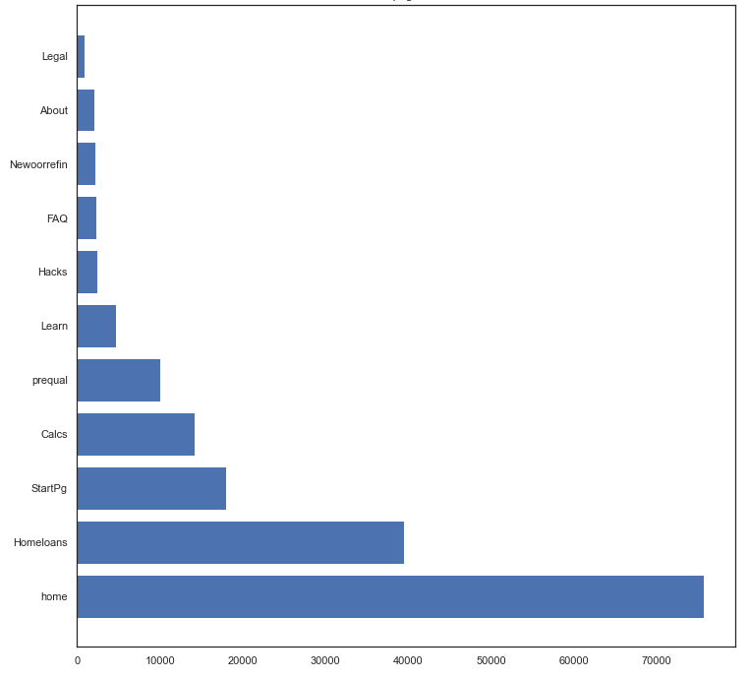
Data and findings – web behaviour and pages
Number of times the pages were visited overall
On average, visitors:
Come to the website 1.7 times
Spend 2 min per session
look at 1-3 pages per session
See the home and homeloans pages
Number of visits
Notes:
This is a guide as there are many outliers

Slide 11
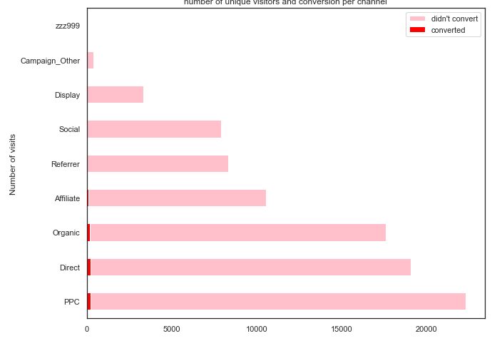
Data and findings – Marketing acquisition channels
Number of unique visitors and conversion per channel
On average, visitors come from:
25% PPC (Google ads)
It represents 32% of the conversions
21% directly to the site, likely returning visitors
It represents 33% of the conversions
20% organically from Google search
It represents 22% of the conversions
12% from affiliates
It represents 10% of the conversions
Number of visits
Notes:
9% from referrer
9% from social media
PPC, direct and organic sources are the most successful ones

Slide 12
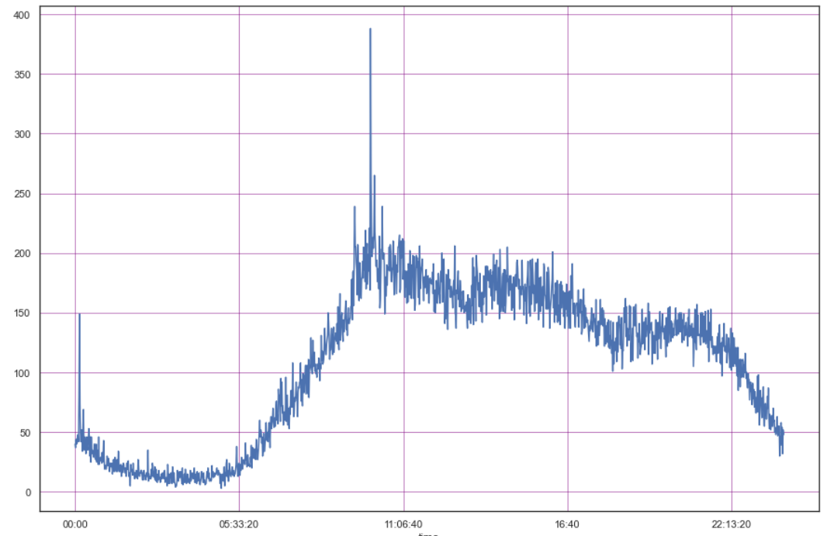
Data and findings – Timing: Time of visit
Time of visit
Visitors browse the site mostly:
Between 8am and 5pm
There’s a peak around 10am
Run ads during work hours only and mostly mornings
Number of visits
0:00
2:15
05:30
08:00
11:00
14:00
16:40
19:00
22:15

Slide 13
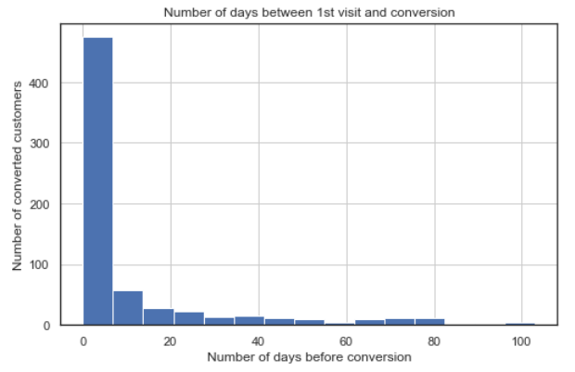
Data and findings – Timing: conversion days
Number of days between first visit and conversion
It takes a first time visitor on average 11 days to convert
But data isn’t balanced, most conversions happen within a few days
We should retarget people within 2 weeks after 1st visit and then reduce ads
Notes:
Nb: As we only recorded 3.5 months and might have missed first visits, this should be used as a rough guide. To get stronger results, analysis should be done over a year.

Slide 14
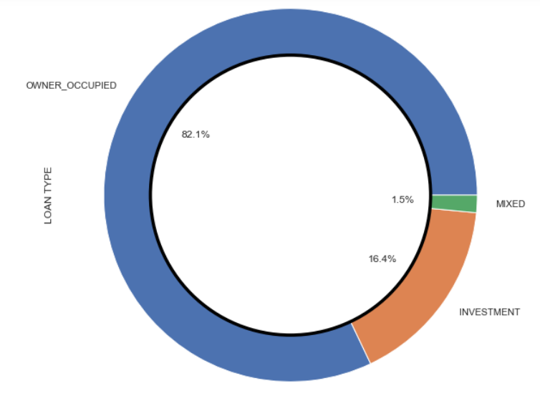
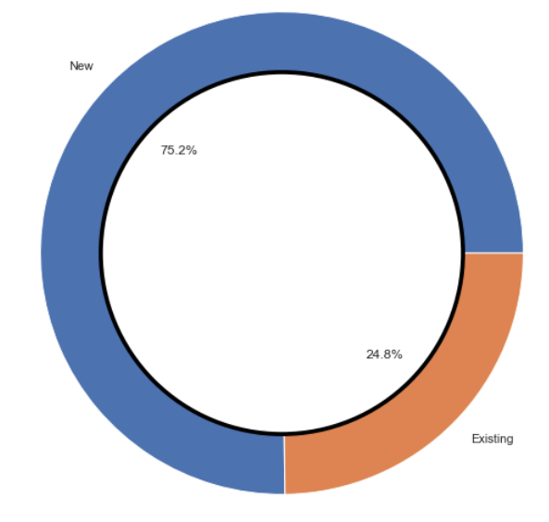
Data and findings – conversions
Out of the 90.205 unique visitors, 730 converted, that represents 0.81%
Most of the applications are first home buyers
Loan type
Application type

Slide 15


Modeling
Using various models to understand what are the key factors driving conversion.

Slide 16
What are we solving again?
Unique visitors in 3.5 months
90.000
Let’s find out what drive conversions
so we can focus on the top features and increase the conversion rate.
730 convers-ions

Slide 17



Project pipeline
1. Data analysis
2. Preprocessing and Modeling
3. Recommend
Notes:
1. Define the business question and analyse data
2. build and evaluate various models
3. Define factors impacting the CONVERSION and provide recommendations

Slide 18
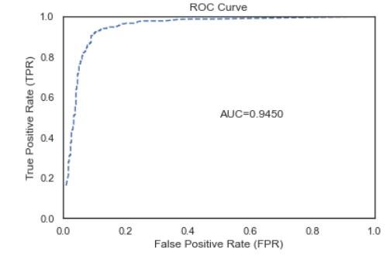
Predictive models
We want to predict customers who will convert
We had to randomly under sample the data as it was too imbalanced
Boosting models were not stable
The Random Forest algorithm returned great results
Model | AUC | Accuracy | Recall | Precision
Gradient Boosting | 1 | 1 | 1 | 1
Random Forest | 0.95 | 0.89 | 0.95 | 0.88
Notes:
The model predicted 406 conversions and only had 23 false negative and 23 false positive

Slide 19
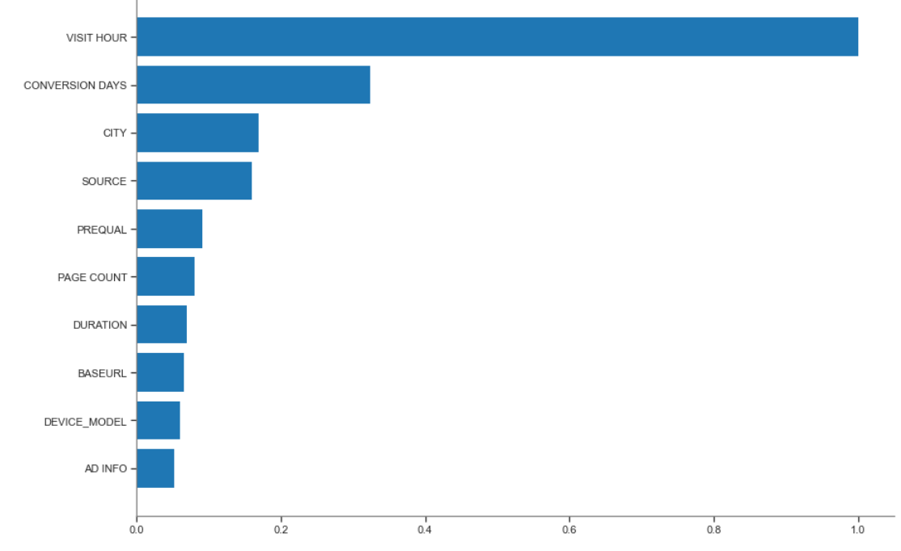
Determining factors
Feature importance from model
The model predicts that these features are the most important to get a conversion:
The time of visit
The number of days between first visit and conversion
Other features like location, source and page visited have a strong impact

Slide 20
Recommendations
Recommendation 1
Recommendation 2
Recommendation 3
Time of visit:
Target users during work hours and mostly around 10am, as it’s the best time to get conversions.
Conversion days
Retarget users in the first two weeks after their first visit only to save budget.
City:
Spend more budget in business districts around the country.

Slide 21


Next steps
Can we go further?
Collect data from longer periods
Add marketing budget
Look at other key features like source
Create stacking ensemble models
Notes:
Stacking is an ensemble machine learning algorithm that learns how to best combine the predictions from multiple well-performing machine learning models.

Slide 22


Any questions?

Slide 23




Thank You
Perrine Mignot
+61 450 446 859
mignotperrine@gmail.com

